Slide 1

Hospital Readmission Rates
Capstone Project
03-09-2020

Slide 2
Agenda
Introduction / Prompt – Jae
Targets – Null Hypothesis
Outline Process (sort of like an agenda, which subsequent teammates will cover)
EDA / Models / Feature Selection – (Think about this for now)
Assumptions of expected important features
Distribution / Missingness
Logistic Reg Model - Rich
Random Forest / Neural Net – Kailun
Decile – Charlie
Conclusion / Summary -
(Based on the best model / models patient outreach team should focus on patients with these traits (features)
Appendix
Feature Selection for Each Model
Notes:
This month we expect (test set)… based off of existing data (test, we have trained models / identified the most robust (best) ones.. End goal is to predict percentages for the test set, should you (the patient interventionist) take further action? Through decile, we
Introduction to methodology (discuss how we separated data )
Conclusion – be specific in recommendation (i.e. thresholds and their readmission rates, etc..)
Feature
In Practice – take a recent month and not use it in training. Use it to apply model
Take out hold out IDs and use for test set
Grid search
- Show in Model Slides
- Model – auc graphs
Compare models across the
Feature import

Slide 3
Objective: Predictive Model Development
Predicts if patient will be readmitted in less than 30 days.
Show how payment and rates are affected.
Describe model implementation and realization.
Model evaluation and performance on AUC, False Positive and True Positive rates.

Slide 4
Dataset & Scope
10 years of clinical care data 1999-2008
Stratified test dataset allocation
It is an impatient encounter
It is a diabetic encounter
The length of stay is at least 1 and at most 14 days.
Laboratory test were performed during the encounter.
Medications were administered during encounter.

Slide 5


Diabetes
A disease of abnormal blood sugar level.
Insulin hormone helps in the control of blood sugar level.
Diabetes happens when pancreas produces very little or no insulin.

Slide 6
People with Diabetes
Use medication to control the blood sugar level.
HbA1c test shows the average blood sugar level over the past 2 to 3 months
Diabetes develop eye, skin, kidney, hearth, and lung disease including neuropathy.

Slide 7
Dataset: Hospital Readmission Rates
10 years of clinical care data 1999-2008
100,000 diabetic impatient encounter with 50 features
Patient data
Diagnosis, Tests and Results, Medications
Admission and discharge related information
Target variable of patient being readmitted to hospital

Slide 8

Features:
Medication

Slide 9
Features:
Diagnostic Codes
Primary, Secondary and Third Diagnosis
International Diagnostic Codes
Grouped into 9 major groups of Diabetes, Circulatory, Digestive, Genitourinary, Neoplasms , Respiratory and Injury
One Hot Encoding Applied

Slide 10
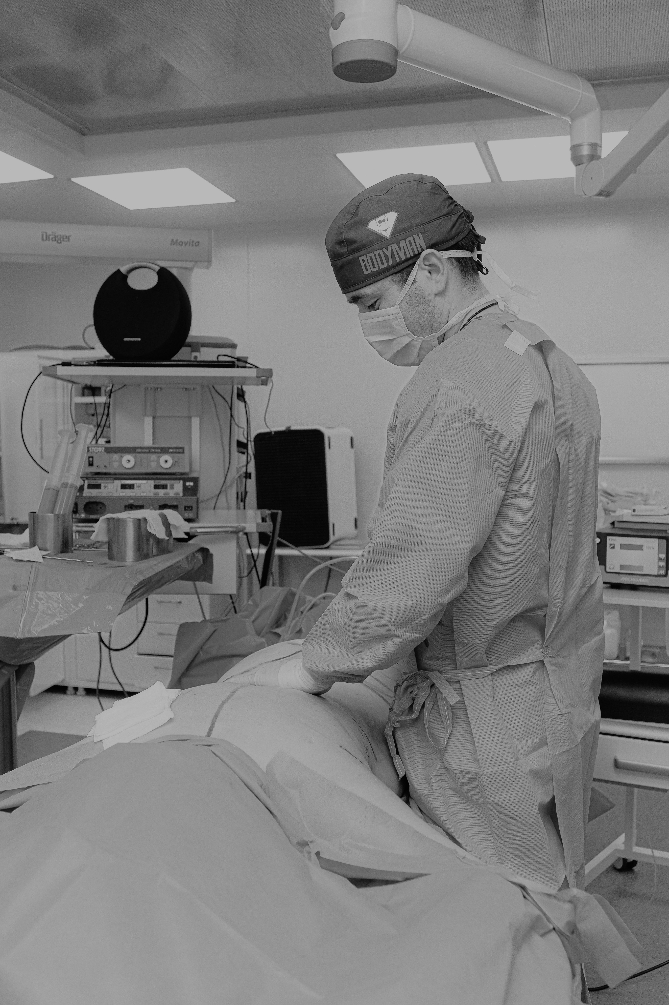
Features:
Medical Specialty

Slide 11
Features:
Discharge

Slide 12
Features:
Admission

Slide 13

Logistic Regression
Cross Validation
Training and Test dataset 0.7/0.3 Ratio
12 Features selected
SMOTE Synthetic Minority Over-Sampling Technique for imbalanced dataset
Hyperparameter Tuning

Slide 14
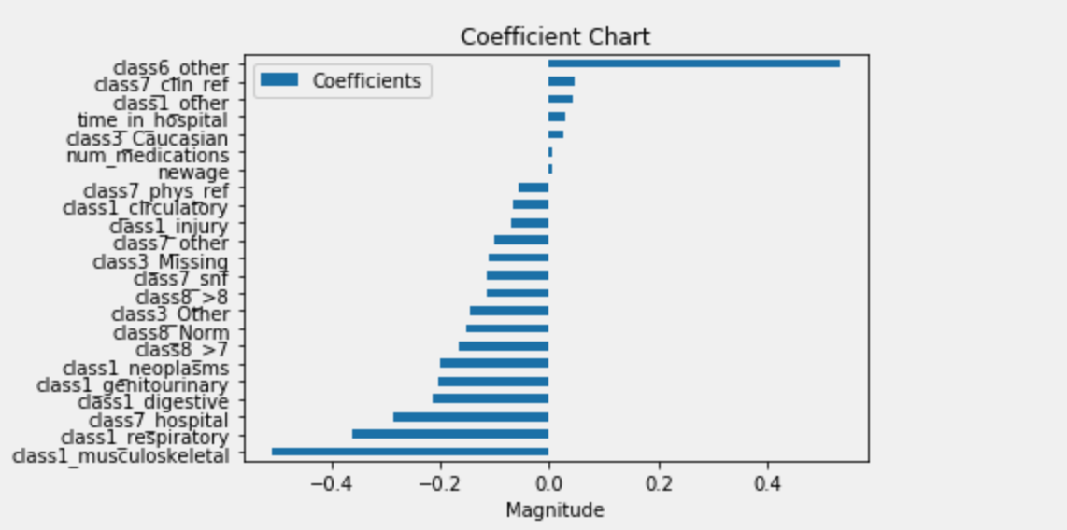
Prediction Results
Coefficients
Significant Coefficiencts with P < 0.05

Slide 15
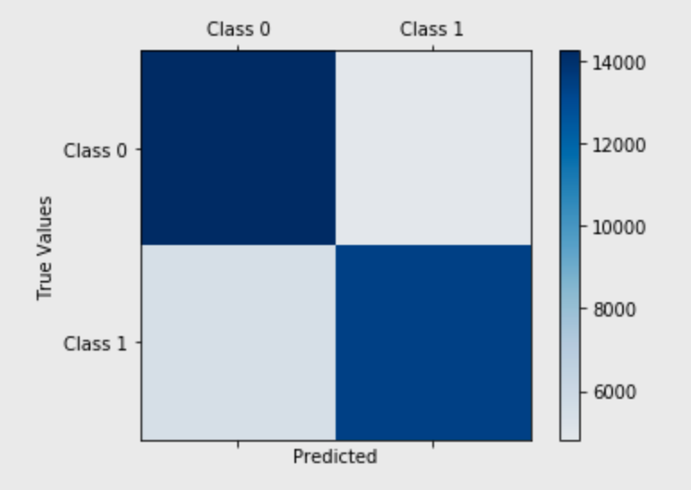
Prediction Results
Confusion Matrix
TP:
TN:
FP:
FN:

Slide 16
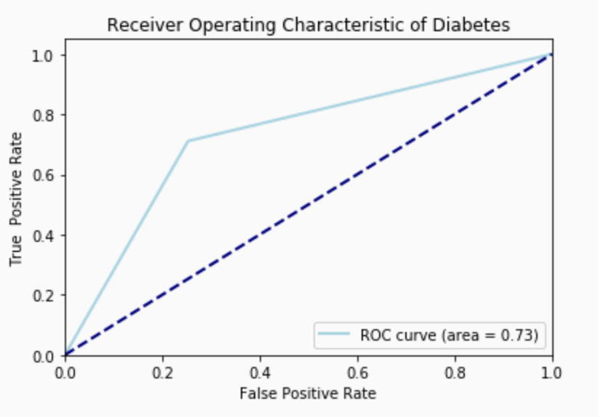
Prediction Results - ROC Curve
ROC curve is used over accuracy to assess prediction

Slide 17
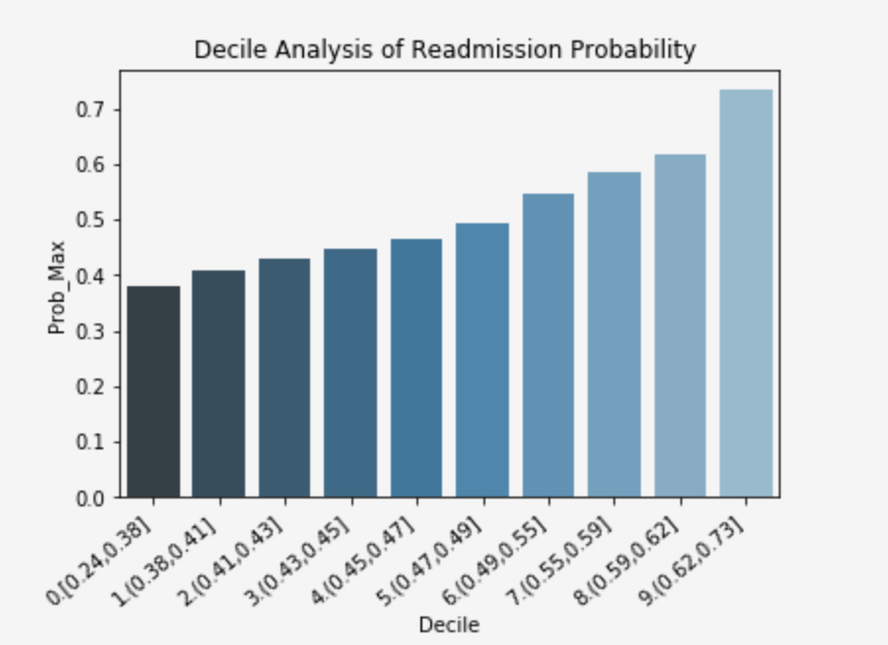
Model Performance - Decile Analysis
Model is able to group patients consistently based on probability of readmission.

